Slide 1
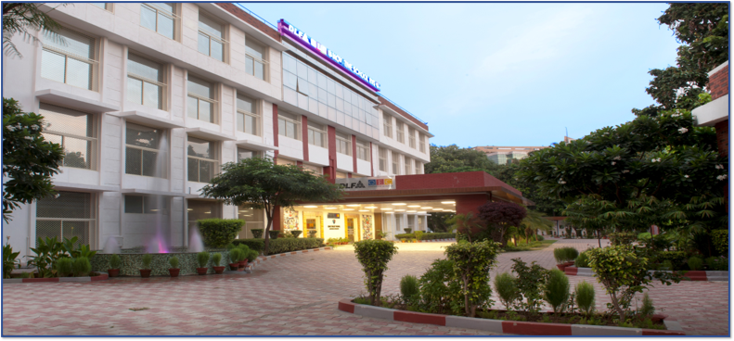
DLF QEC INNOVATIVE SCHOOL
RIDGE VALLEY
GRADE VI ORIENTATION
SESSION : 2024-25

Slide 2
FACILITATORS
Mentor : Ms. Neelu Singh Email : neelu.s@ridgevalleyschool.org
Class Teacher VI A : Ms. Her Simran Email : hersimran.k@ridgevalleyschool.org
Class Teacher VI B : Ms. Archna Jain Email : archna.j@ridgevalleyschool.org

Slide 3
SUBJECT COORDINATORS
Department | Name of the Facilitator
English | Ms. Tanvi Chugh
Third Languages | Mr. Vivek Yadav
Mathematics | Mr. Chander Prakash Arora
Social Science | Ms. Sonali Malik
Science | Mr. Vivek Yadav
IT | Ms. Akanksha Sehgal
Wellness | Ms. Parul Banga
Sports | Mr. Dharamveer Singh Chauhan

Slide 4
SUBJECT TEACHERS
Subject | Name of the Teacher
English | Ms. Shalini Batra
Hindi | Ms. Pramila Dutt
Third Language | Ms. Komal Kaur Narula (Spanish) Ms. Hanit Kaur (French) Ms. Kanika Anand (German) Mr. Rakesh Sharma (Sanskrit)
Mathematics | VI A - Ms. Her Simran VI B - Ms. Swati Sabherwal
Science | Ms. KS Sangeetha
Social Sciences | Ms. Archna Jain
ICT | Ms. Rohika Singla

Slide 5
ANNUAL CALENDAR
Month | No. of Saturdays & Sundays | No. of Holidays | No.of Working days | Important days and events
April | 8 | 2 | 20 | Cricket Tournaments, STEM Expo, Inter House Group Dance Competition
May | 8 | 1 | 13 | Unit Test- 1, Declaverse, Summer Camp, Duet Singing and Music Band Competition
June | Summer Break -44 days
July | 8 | 1 | 22 | Book Week, Meraki
August | 8 | 3 | 19 | Inter School Soccer, Inter School Shatranj
September | 9 | 1 | 20 | Mid Term Examinations
October | 8 | 6 | 17 | Inter House Soccer Tournaments, Sports Day
November | 9 | 2 | 19 | Unit Test 2
December | 8 | 2 | 19 | Annual Day, Winter Carnival
 | Winter Break – 8 days
January | 7 | 5 | 16
February | 8 | 1 | 19 | EFL Student Appreciation ceremony
March | 10 | 2 | 14 | Final Assessments

Slide 6
ASSESSMENT CYCLES
ACADEMIC SESSION IS DIVIDED INTO TWO TERMS
Term I
Exam | Marks | Tentative Dates | Days
Unit Test-I | Theory - 20 | 6th May-17th May 2024 | Mondays, Wednesdays, Fridays
Mid Term | Theory -50 (2 hours – Including Reading Time) | 6th September – 19th September 2024 | Alternate days
Internal Assessments | 30 | Will be conducted on a regular basis.

Slide 7
ASSESSMENT CYCLES
ACADEMIC SESSION IS DIVIDED INTO TWO TERMS
Term II
Exam | Marks | Tentative Dates | Days
Unit Test-II | Theory- 20 | 11th November – 28th November 2024 | Mondays, Wednesdays, Fridays
Final Term | Theory -50 (2 hours – Including Reading Time) | 3rd March – 17th March 2024 | Alternate days
Internal Assessments | 30 | Will be conducted on a regular basis.

Slide 8
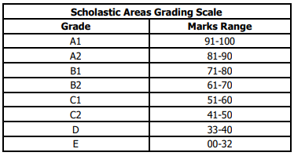
ASSESSMENT- SCHOLASTIC AREAS
Students will be graded on a 9-point grading scale.
Mid Term Exam will comprise of 50 % of the annual syllabus.
Final term will have topics from Term II and 10% from Term I.

Slide 9
INTERNAL ASSESSMENT
Internal Assessment
Unit Tests
Multiple Assessment
Portfolio / Notebooks (This will include Art Integrated Projects )
Subject Enrichment

Slide 10
HOLISTIC PROGRESS CARD

Slide 11
HOLISTIC PROGRESS CARD
360 DEGREE REPORT
Self-assessment and Peer assessment
A 360-degree, multidimensional report of progress, that reflects in detail the progress as well as the uniqueness of each learner in the cognitive, affective, socio-emotional, and psychomotor domains.
HPC includes self-assessment and peer assessment, and progress of the child in project-based and inquiry-based learning, quizzes, role plays, group work, portfolios, etc., along with teacher assessment.
Important link between home and school
Tool for teachers & parents
HPC will be accompanied by parent-teacher meetings in order to actively involve parents in their children’s holistic education and development.
HPC would also provide teachers and parents with valuable information on how to support each student in and out of the classroom.

Slide 12
Non-Hierarchical and Neutral icons
Beginner
Progressing
Proficient
The student is at the beginning stage of target competency and needs a great deal of support and handholding.
The student is able to meet some part of target competency independently but needs some (occasional) support and handholding.
The student is able to meet target competency independently, without any support.

Slide 13
This goal continues to provide experience for health and well-being, physical and motor development, socio-emotional development, nutrition, hygienic practices and safety.
Once the foundation of language and literacy are laid, this goals lead to subjects like – English, Hindi, Sanskrit, Spanish and German
Children become involved learners and connect with their immediate environment.

Slide 14
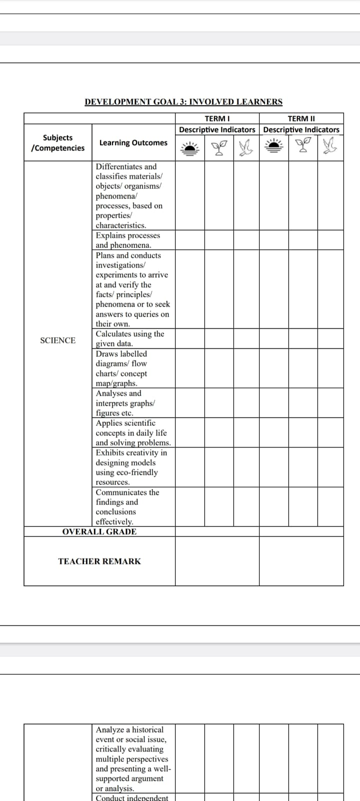
HOLISTIC
PROGRESS
CARD

Slide 15
HOLISTIC PROGRESS CARD

Slide 16
HOLISTIC PROGRESS CARD

Slide 17
HOLISTIC PROGRESS CARD

Slide 18
HOLISTIC PROGRESS CARD

Slide 19
GENERAL GUIDELINES
Formal Assessments and Examinations are mandatory.
2. The School has a No-Retest Policy.
3. In case of illness or emergencies during an
exam, a Doctor’s certificate must be produced.
4. As per CBSE rules, a student must have 75%
attendance to be able to appear in the Final Examinations.

Slide 20
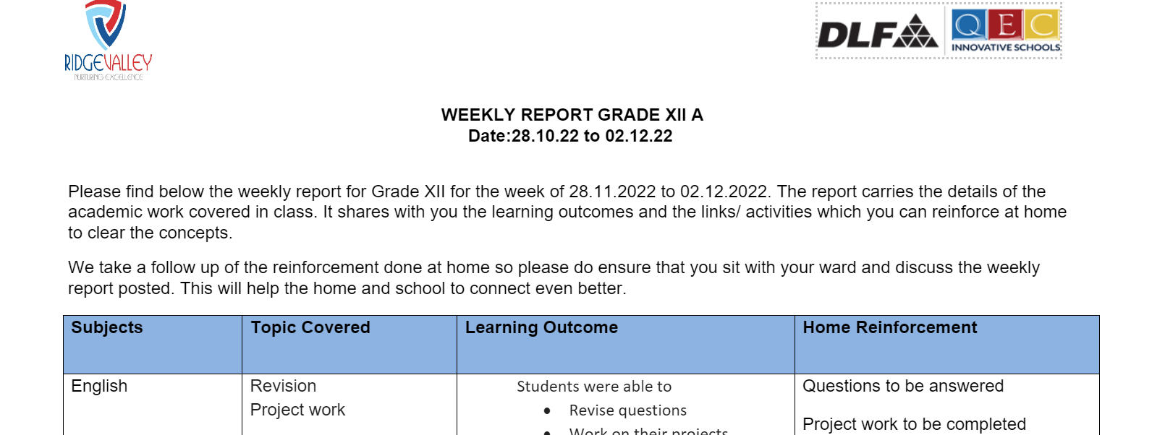
CHECKING SCHOLASTIC AREAS
Parents to check weekly report every Friday on the Edunext ERP for:-
- Home reinforcements - for a recap of the topics covered in school.
- General reminders - having important dates and upcoming events.
- Activities done over the week.

Slide 21
EDUNEXT ERP – This domain helps to connect with the school daily. Information such as homework, weekly reports, circulars, results etc. are uploaded on a regular basis.
Note : Parents should download the application on their personal mobile.
2. Parent Teacher Meetings (PTM)
3. Working Saturdays (Twice in a month)

Slide 22
ATTENDANCE & LEAVE PROCEDURE
Regularity to School is important for the overall development of the child.
Application for leave needs to be mandatorily submitted to the Class Teacher via E-mail. If on medical ground the child must produce the Doctor’s certificate.
Child does not attend school for 1-3 days due to any family event/ travel or on medical ground
Application for leave needs to be mandatorily submitted to the PRINCIPAL for approval via the Class Teacher prior the event.
Child does not attend school for more than 3 days(Planned Vacations/Family Events)

Slide 23
CLUBS AND CARPE-DIEM​
Skill Development
(Will be conducted once in a week )
SPORTS AND FITNESS
(Will be conducted twice in a week )
CLUBS
(Will be conducted once in a week )
Indian Dance
Western Dance
Western Vocal
Indian Vocal
Pottery/clay modeling
Art and Craft
Theatre
Instrumental Music
Tabla
Music Production and Sound Engineering
Eureka Science club
Digital media
Linguistic
Mathletics
Heritage
Eco warriors
MUN
Music Production and Sound Engineering
Cricket
Football
Golf
Gymnastics
Basketball
Lawn tennis

Slide 24
SCHOLASTIC AND CO-SCHOLASTIC AWARDS
.​
Students will be eligible for the following awards at the end of academic session based on their performance in following areas:-
Attendance
Academic Awards
Special Awards

Slide 25
MENTAL HEALTH AND WELL-BEING SESSIONS
.​
Mental Health and Well Being Sessions are an integral part of our curriculum.
Ms. Parul Banga, Coordinator V-Care Centre will be taking the following sessions with our students on regular basis.
Months | Session Topic
April | Celebrating Inclusion
May | Bullying
July | Teenage brain
August | Cleanliness drive
September | Handling Exam Stress
October | Overcoming jealousy and comparison
November | Peer Pressure
December | Anger management
January | Adolescence and Body Image
February | Respecting Personal Space
March | Exam stress

Slide 26
EDUCATION FOR LIFE(EFL)
EFL teachings emphasize 'Self-realisation' as direct inner experience of God. These teachings are based on India 's timeless universal truths and offer practical solutions to the challenges of modern life.
1. These classes will be taking place once a week with their
EFL in charge.
2. Some of the values and 21st century skills that will be
taken up during these sessions are:
Social Skills | Thinking Skills | Emotional Skills
Self Awareness | Critical Thinking | Coping with Stress
Empathy | Creative Thinking | Coping with Emotions
Effective Communication | Decision Making
Interpersonal Relationship | Problem Solving

Slide 27
PARENT DROP-OFF & PICK-UP
1. School Timings – 8:30 am to 2:55 pm
2. Pick-up Cards - Card to be produced for verification whenever and wherever
required.
3. Student would be handed over to the person specified in the Pick-up Card only.
4. Avoid early pick-up.
5. In case of any exception a written application seeking permission from the
Principal needs to be produced.
6. If students are walking back unescorted , parents are requested to write a mail to
the class teacher.
7. If in case, you want someone else to pick your ward, kindly write a mail to the
school. The person must produce his Govt ID.

Slide 28
DISCIPLINE & DECORUM
1. Hair to be cut and neatly combed. In case of girls, long
hair to be tied in ponytail with navy blue or black hair
bands or clips and rubber bands only to be used.
2. Nails to be trimmed, nail paints not allowed.
3. Long dangling or fancy earrings is not permitted. Girls
must wear ear studs.
4. For boys wearing turban the colour should be navy blue.
5. School Uniform – Formal school uniform must be
worn on Monday, Tuesday and Friday
6.House Uniform must be worn on Wednesday and Thursday.
7. Black Shoes with black soles must be worn with the School
Socks.

Slide 29
SPOCS
Department | Name of the Facilitator | E-Mail Address
Accounts | Mr. Shiv Veer Singh | accounts@ridgevalleyschool.org
Transport | Mr. Yogesh Malasi | estate@ridgevalleyschool.org
Front Desk | Ms. Samiksha Khatri | info@ridgevalleyschool.org
ERP | IT Team (Mr. Manoj Sharma, Mr. Biswaranjan Dhal) | ittech@ridgevalleyschool.org

Slide 30
SCHOOL TIMINGS
8:25 am – 2:55 pm
(The school gates will close at 8.30 am sharp)
Classes beginning from Monday, 1st April, 2024.

